Slide 1

WoodCreek of Canton
Annual HOA Meeting
November 14, 2022 7:00 PM – 9:00 PM
Woodcreeksub.hoa@gmail.com

Slide 2
Agenda
Our Subdivision
Board of Directors up for re-election:
  Dave Sanders, Treasurer 2 year term. Seeking a 3rd term.
  Sanket Sirpotdar, At Large 2 year term. Seeking a 2nd term.
  If you have any questions about the duties of these officers, you can look at our by-laws posted on our website at Woodcreekofcanton.com.
Financial Reports
Open Issues
Q & A

Slide 3





Welcome new neighbors!

Slide 4
Our Subdivision
We are a Neighborhood of Homeowners, including;
  88 Single Family homes
  3 Entrances/Exits
  Common Areas / Protected Wetlands (refer to discussion pg. 12)
  HOA Board of Directors
  By-Laws, covenants, conditions, and restrictions (CC&Rs)
  Annual Dues

Slide 5
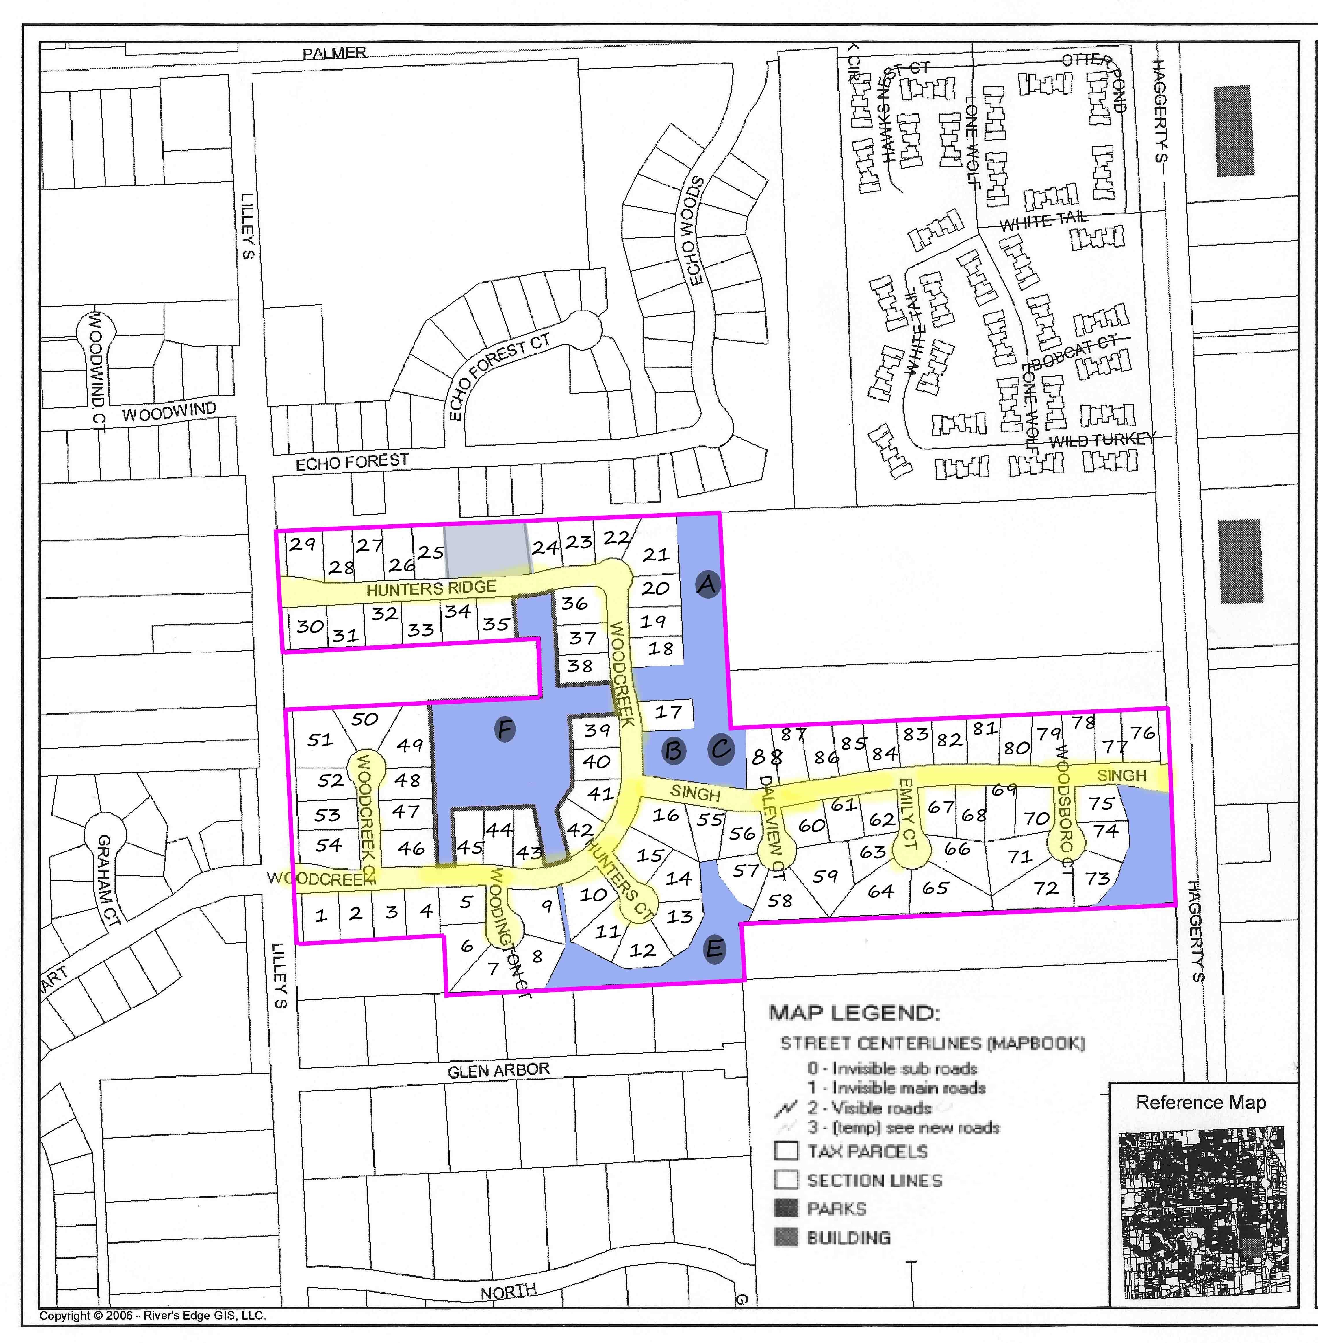
5

Slide 6
HOA Board of Directors
6
  Our Board of Directors are made up of members of the Association, and are all volunteers. We welcome your participation on our board, or volunteering on a committee.
  If you have any questions about the duties of these officers, you can look at our by-laws posted on our website at Woodcreekofcanton.com.
  We also have three committees in need of volunteers: Roads/Infrastructure, Welcoming/Homeowner Relations, and Landscape/Architecture/Decorations.
Position | Name | Term
President | Martha Willis | January 2022-2024
Treasurer | Dave Sanders | January 2021-2023 Up for Re-election
At-Large | Geeta Dhande | January 2022-2024
At-Large | Molly Wildman | January 2022-2024
At-Large | Sanket Sirpotdar | January 2021-2023 Up for Re-election

Slide 7
Why We Are Here
Your HOA board exists
  to manage our resources, including collection/disbursement of assessments and maintenance of Common areas.
  cultivate tangible and intangible ways for us to grow as a neighborhood, within the bounds of powers given by our bylaws.
  “and to promote the recreation, health, safety, welfare, common benefit and enjoyment of the Owners” per our bylaws.
  To contribute to making Woodcreek a delightful and desirable place to live - we know you share this value as Woodcreek residents!

Slide 8

Financial Reports

Slide 9
Woodcreek of Canton

Slide 10
Annual Dues
Current dues
  $450 per year – Due March 31st
  X Homes behind on payment
  Collection methods
Future Expenses
  Road Repair
  Entrance Upkeep

Slide 11
Major Contracts
Spring/Fall plantings (Northstar Property Maintenance)
Summer mowing (Northstar Property Maintenance)
Spring/Fall Clean Up / Weeding (Northstar Property Maintenance
Snow & Ice Removal (salting) ( Northstar Property Maintenance)

Slide 12
Open Issues
Infrastructure
  Road repairs
  Drain repairs
  Electrical work on South Lilley Entrance
  Wetlands and trees (Trees are protected in the wetlands. If a tree falls on a homeowner’s property, the homeowner is responsible for removal. Please contact your homeowner’s insurance for any occurrence.
Holiday Decorations will be put up after Thanksgiving by volunteers and the HOA Board

Slide 13
Building a Woodcreek Community
Our Carnival block party had a great turnout! Thank you to all that helped and participated.
  Highlights included: Kona ice truck, Inflatable for kids, getting to know neighbors
Halloween Luminaries
  Gave streets an inviting atmosphere, helped guide kids and parents. Thank you to Geeta for organizing and others who helped to set it up!

Slide 14

Q&A
woodcreeksub.hoa@gmail.com
www.woodcreekofcanton.com

